Slide 1
Ecommerce Java Project
Adriana Militaru

Slide 2
Technical requirements used in the app:
Spring Boot
Java 21
Maven
PostgreSQL
Hibernate as ORM (the default one provided by Spring)

Slide 3
The database has 4 tables with four to many REST APIs(endpoints) each, for each CRUD(Create, Read, Update, Delete) operation:
GET /READ
http://localhost:8080/api/collections/allproducts
ADD/CREATE
http://localhost:8080/api/collections/add
UPDATE/MODIFY
http://localhost:8080/api/collections/modify/{id}
DELETE
http://localhost:8080/api/collections/allproducts/{id}
http://localhost:8080/api/collections/category/{categoryId}
http://localhost:8080/api/collections/checkout/discount/{id}
http://localhost:8080/api/collections/delete/{id}
COLLECTIONS

Slide 4
Clean code -> packages: domain, api, dto.
GET /READ
http://localhost:8080/api/category/menu
ADD/CREATE
http://localhost:8080/api/category/add
UPDATE/MODIFY
http://localhost:8080/api/category/modify/{id}
DELETE
http://localhost:8080/api/category/delete/{id}
CATEGORY

Slide 5
Name convention used -> Dto, Controller, Repository, Entity.
GET /READ
http://localhost:8080/api/sale/discount/{id}
ADD/CREATE
http://localhost:8080/api/sale/add
UPDATE/MODIFY
http://localhost:8080/api/sale/modify/{id}
DELETE
http://localhost:8080/api/sale/delete/{id}
SALE

Slide 6
Used one-to-many relationship DB mapping (one cart could have multiple products / one category has multiple products).
GET /READ
http://localhost:8080/api/cart
ADD/CREATE
http://localhost:8080/api/cart/add
UPDATE/MODIFY
http://localhost:8080/api/cart/modify/{id}
DELETE
http://localhost:8080/api/cart/delete/{id}
http://localhost:8080/api/cart/{id}
CART ITEM

Slide 7
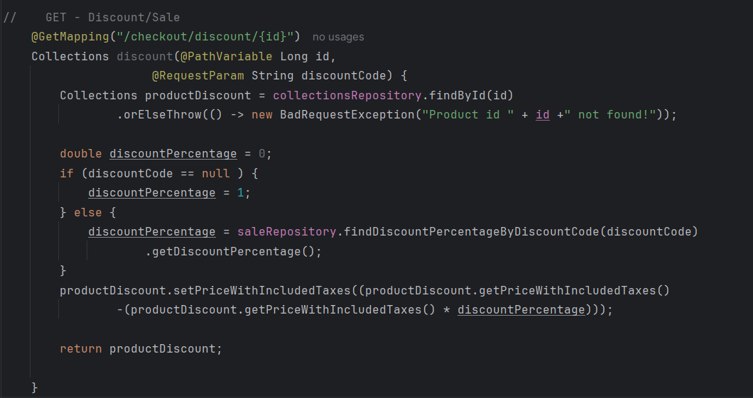
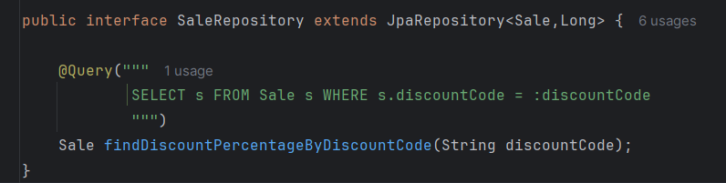
Created one endpoint with more complex query behind it -> a GET API that retrieves data with @RequestParam and @PathVariable. Also used for this @Query,as in the example below:

Slide 8

The data base has been populated using POST APIs

Slide 9
Hope you enjoy the project! Thank you!

